Slide 1
Free Body Diagrams

Slide 2
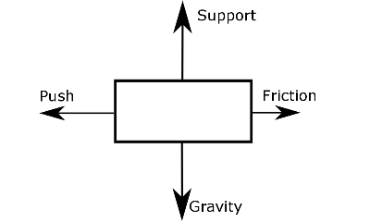
In this Smart Lesson you will learn to:
Recall types of forces.
Construct free-body diagrams representing forces acting on an object.

Slide 3
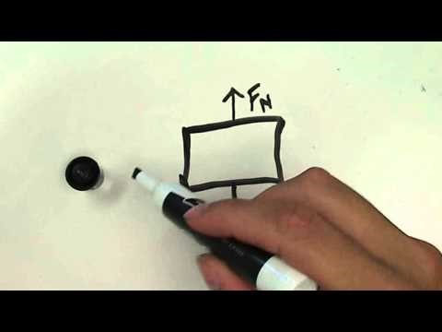

Slide 4
Free-body diagrams.
Before we go on to look at applications of gravitational theory, there is a very handy technique you should be familiar with. It is called a free-body diagram and it allows us to analyse the forces acting on a single object.

Slide 5


Slide 6
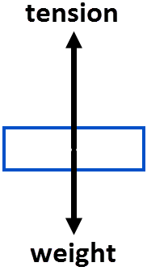
Free-body diagrams are a simple way to represent the forces on an object.
The object is drawn as a simple shape, such as a circle or rectangle.
The forces acting on the object are drawn as vector arrows.
The length of the arrows represents the magnitude of the force, whilst the direction of the arrow shows the direction the force acts.

Slide 7
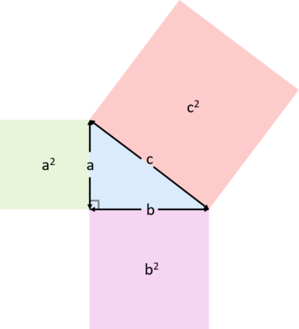

So how are net forces calculated?
When forces are in one dimension they can be added if they are in the same direction, or subtracted if they are in opposite directions.
When forces are in two dimensions, Pythagoras' theorem must be used to calculate the net force.

